Slide 1

RISK ASSESSMENT - JOB SAFETY
ANALYSIS
Presented by:
Joel N. Tietjens
CSP, CSHM
T-JENS & T-JENS, INC.
June 07, 2005
© 2005 T-JENS & T-JENS, INC.

Slide 2

RISK
ASSESSMENT
PROCESS
© 2005 T-JENS & T-JENS, INC.

Slide 3
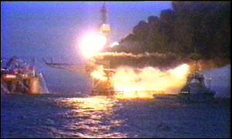
RISK
Risk
  The probability and severity of loss from exposure to a hazard
Piper Alpha
© 2005 T-JENS & T-JENS, INC.

Slide 4
RISK
How much risk is acceptable by the organization?
The acceptance of risk by any organization should be based on the following
PROBABILITY (of it occurring)
SEVERITY (if it does occur)
COST OF CONTROL (cost to the organization to control it)
Ignoring risk is not always risky!
© 2005 T-JENS & T-JENS, INC.

Slide 5
THE LOGIC OF RISK ASSESSMENT
Risk Criteria
Identify the hazard(s)
Calculate or estimate the likelihood of occurrence
Is risk in acceptable range
YES
Postulate a loss scenario
Calculate the Risk
Log results on Risk Summary Report
Calculate or estimate the consequence
NO
Apply Mitigations
Application of Cost Benefit analysis as Required
Add Mitigation to Risk Summary Report
© 2005 T-JENS & T-JENS, INC.

Slide 6
WHY RISK ASSESSMENT?
Injuries, Damage, other Losses
Performance loss or degraded
Public/program impact
Understanding the Hazards and their role in incidents
Managing risk through reduction of Oversight and Omission errors
Or
Oversights
and/or
Omissions
Assumed Risk
Our Goal is to move from
Oversight and Omission to Assumed Risk
© 2005 T-JENS & T-JENS, INC.
Notes:
The ultimate purpose for assessing risk is to manage loss, damage, or waste through an understanding of the associated risk. Risk management is the systematic application of engineering or other resources to manage risk.

Slide 7
RISK ASSESSMENT MATRIX
Risk Assessment Code
1 = Critical
2 = Serious
3 = Moderate
4 = Minor
5 = Negligible
Probability of Occurrence
Likely
Probably
May
Unlikely
A
B
C
D
S
Cat I
Catastrophic
1
1
2
3
E
V
Cat II
Critical
1
2
3
4
E
R
Cat III
Marginal
2
3
4
5
I
T
Y
Cat IV
Negligible
3
4
5
5
Risk Levels
© 2005 T-JENS & T-JENS, INC.
Notes:
Lead class discussion. Discuss the usefulness of a matrix of this type.

Slide 8
BENEFITS OF
RISK ASSESSMENTS
Identify hazardous conditions & potential conditions
Provide information with which effective control measures can be established
Determine level of knowledge & skill employees need to execute their duties
Discovering & eliminating unsafe procedures, techniques, actions
© 2005 T-JENS & T-JENS, INC.
Notes:
Lead class discussion.

Slide 9
JOB SAFETY ANALYSIS
(JSA)
© 2005 T-JENS & T-JENS, INC.

Slide 10

WHAT IS JOB SAFETY ANALYSIS (JSA)
A method of studying a job in order to:
  (a) Identify hazards or potential incidents associated with each step or task and
  (b) Develop solutions that will eliminate, nullify, or prevent such hazards or incident potential
© 2005 T-JENS & T-JENS, INC.
Notes:
Notes:

Slide 11
WHAT IS JOB SAFETY ANALYSIS (JSA)
Other names that JSA is known by:
  Job Hazard Analysis
  Job Task Analysis
JHA
JTA
© 2005 T-JENS & T-JENS, INC.

Slide 12
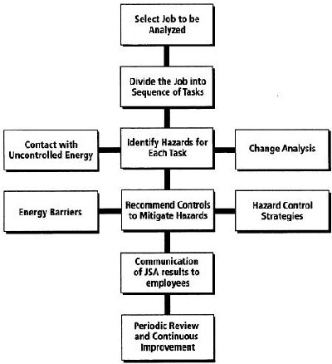
BENEFITS OF JSA
Establishes job performance standards, a standard operating procedure
Eliminates or minimizes incidents
Creates a job training tool
  New employee(s)
  Pre-job instructions, irregular jobs
Used for job observation
Aids in incident investigations
© 2005 T-JENS & T-JENS, INC.
Notes:
Notes:

Slide 13
BENEFITS OF JSA
Jobs for possible improvement in job methods
Makes safety and health a part of the production process, not an add-on
To
  Encourage teamwork (especially with new employees)
  Involve everyone performing the job in the process
  To elevate awareness
© 2005 T-JENS & T-JENS, INC.

Slide 14

SELECTION OF JOBS TO BE ANALYZED (ASSESSMENTS)
Accident/Incident Frequency
Injury Rate
  First Aid
  Recordable
  Lost Time
The potential for serious injury
New jobs
Modified jobs
Includes health & ergonomic issues
© 2005 T-JENS & T-JENS, INC.
Notes:
Notes:

Slide 15
BEGINNING THE PROCESS
Management support
Establishing goals and expectations
  Realistic
Job task training & education
Selecting the job(s)
Person(s) to perform the analysis
Actual development of the JSA
© 2005 T-JENS & T-JENS, INC.
Notes:
Notes:

Slide 16

PERFORMING THE ANALYSIS
Line Management (Supervisors)
Employee that has experience with job
Group Involvement - those that do the job
Use safety professionals or practitioners as guidance & resource
Communications
© 2005 T-JENS & T-JENS, INC.
Notes:
Notes:

Slide 17
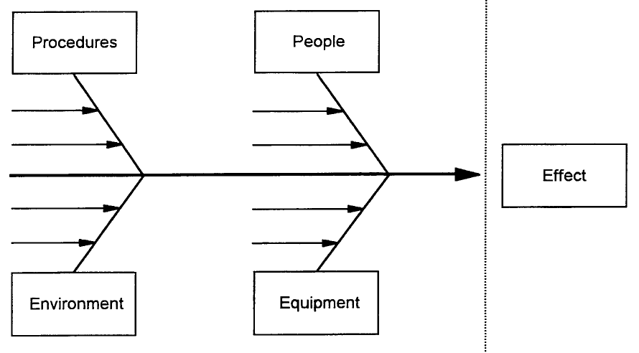
CAUSE AND EFFECT DIAGRAM (COURTESY OF NATIONAL SAFETY COUNCIL)
© 2005 T-JENS & T-JENS, INC.
Notes:
Notes

Slide 18

THREE STEP PROCESS
Break the job down into steps
Identify hazards in each step
Actions to take to eliminate or minimize the hazards
© 2005 T-JENS & T-JENS, INC.
Notes:
Notes:

Slide 19

BREAK THE JOB DOWN INTO STEPS
Select the right worker to observe
Identify observable steps
  What is done,
  not how
Could be 5 to 15
  Rule of thumb
  Videotaping
Number sequentially
Verify with the worker
© 2005 T-JENS & T-JENS, INC.
Notes:
Notes:

Slide 20

IDENTIFY HAZARDS IN EACH STEP
Ask questions of the
  Job task
  Equipment
  Environment
© 2005 T-JENS & T-JENS, INC.
Notes:
Notes:

Slide 21
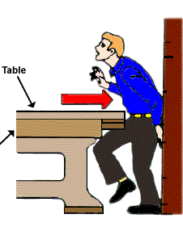
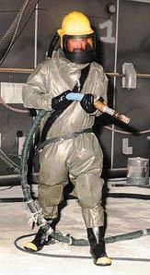



IDENTIFY HAZARDS IN EACH STEP
Examples:
  Caught in or between
  Struck by
  Slip & fall
  Lifting
  Dust
  Repetitive motion
  Radiation
  Heat
  Noise
  Work platform/station
  Etc.
© 2005 T-JENS & T-JENS, INC.

Slide 22
ACTIONS TO TAKE TO ELIMINATE OR MINIMIZE THE HAZARDS
Eliminate
Engineering
Administrative
Personal Protective Equipment (PPE)
Combination of all
EAP
© 2005 T-JENS & T-JENS, INC.
Notes:
Notes:

Slide 23

ACTIONS TO TAKE TO ELIMINATE OR MINIMIZE THE HAZARDS
Find new way(s) to do the job
Change the physical conditions that create the hazard(s)
Change work procedure
Reduce the frequency
© 2005 T-JENS & T-JENS, INC.

Slide 24

PHYSICAL vs. HEALTH HAZARDS
Assess the job for health and ergonomic elements
Many health & ergonomic elements are developed over a long period of time, i.e., hearing loss, respiratory ailments, cumulative trauma disorders
© 2005 T-JENS & T-JENS, INC.
Notes:
Notes:

Slide 25

SHORTCOMINGS OF JSA’S
All hazards not identified
Action not being taken for the hazards identified
Not being specific on action to take for each hazard
Being too specific on steps
Being too general on steps
© 2005 T-JENS & T-JENS, INC.
Notes:
Notes:

Slide 26

JSA PROCESS
JSA program must remain visible
A review process should be developed & JSA’s updated when necessary
  Job changes, altered
  What is done
  Incident information determines JSA was flawed
How will the JSA’s be used?
© 2005 T-JENS & T-JENS, INC.
Notes:
Notes:

Slide 27
JSA SAMPLES
© 2005 T-JENS & T-JENS, INC.

Slide 28
BANDING PALLETS
© 2005 T-JENS & T-JENS, INC.

Slide 29
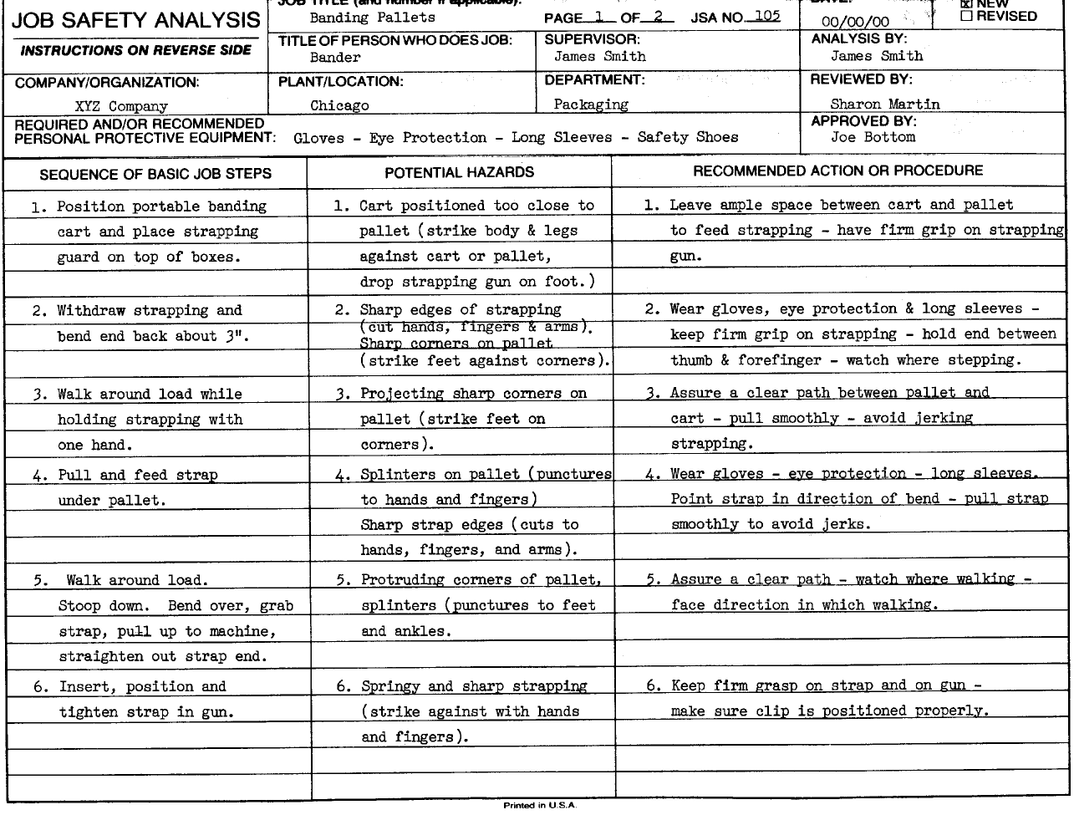
JSA SAMPLE
(COURTESY OF NATIONAL SAFETY COUNCIL)
© 2005 T-JENS & T-JENS, INC.

Slide 30
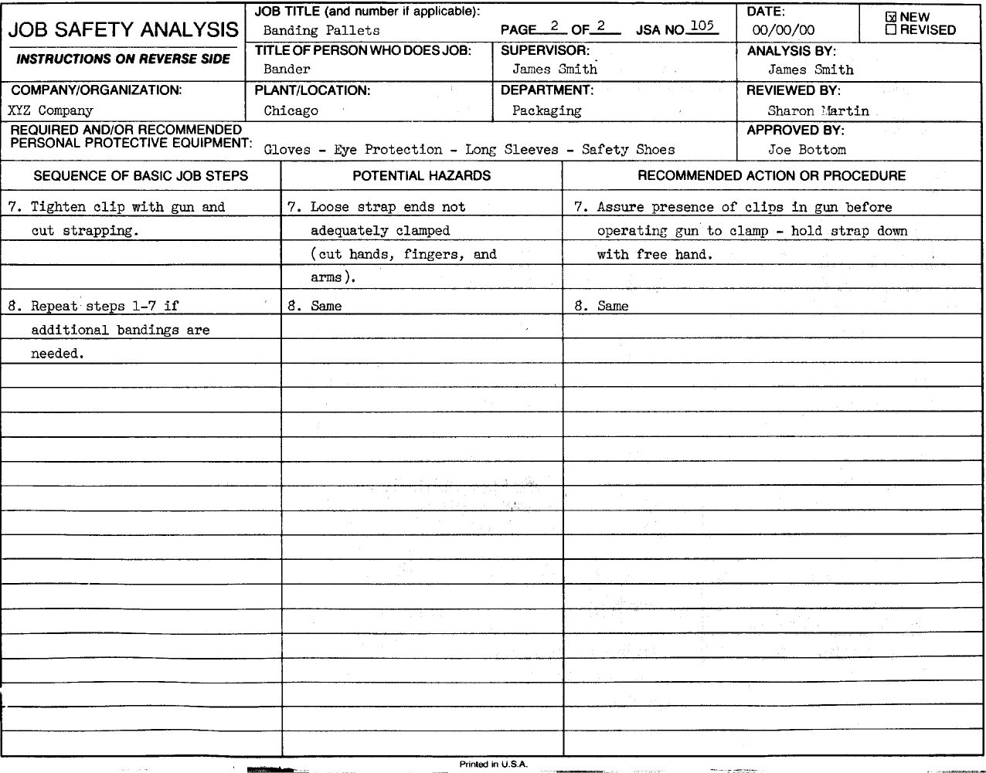
JSA SAMPLE
(COURTESY OF NATIONAL SAFETY COUNCIL)
© 2005 T-JENS & T-JENS, INC.

Slide 31

RISK ASSESSMENT - JOB SAFETY
ANALYSIS
Presented by:
Joel N. Tietjens, CSP, CSHM
T-JENS & T-JENS, INC.
18803 Whitewood Drive, Spring, TX 77373-5613
Office: 281/353-3680 Fax: 281/288-6952
E-Mail: Joel@tjens.com Web: www.tjens.com
© 2005 T-JENS & T-JENS, INC.

